Slide 1
Business
What do organisations expect from you?

Slide 2
Motivation

Slide 3
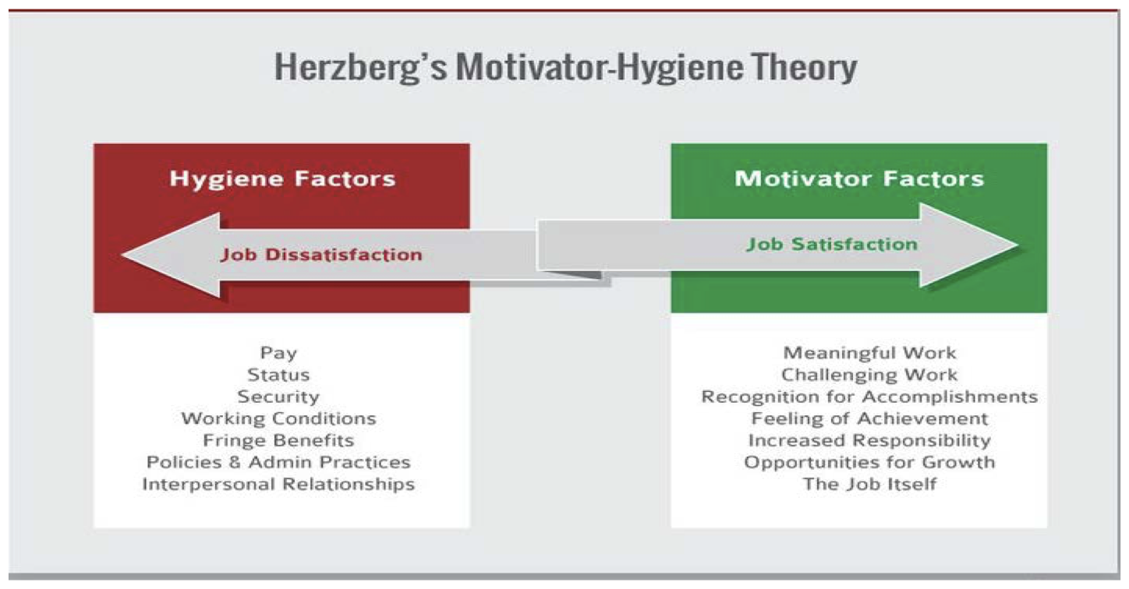

Slide 4
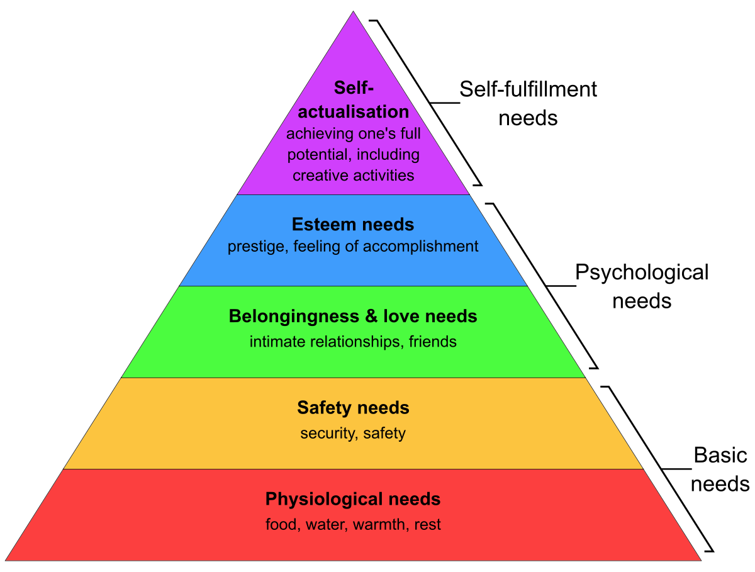
Maslow’s Motivational Model

Slide 5
CV vs Resume
CV
has no length limit
should detail the whole course of your career
Is used for academic purpose
Resume
is one two pages long
should only include those details about your work experience and skills that are relevant to the job opening
is used to apply for jobs

Slide 6

Q&A

